Slide 1
The Tuscany Project in the Apache Incubator and
The Service Component Architecture
Jeremy Boynes
Simon Nash
28 June 2006

Slide 2
Outline
Introduction to the Service Component Architecture Specification
The state of the Tuscany Project
Looking forward …

Slide 3
Service Component Architecture
A programming model for developing services using component assembly
Multiple languages, multiple container technologies, and multiple service access methods
Declarative policies for infrastructure services
  security, transactions, reliable messaging
Business-level model for implementing services
  service components with service interfaces
  no technical APIs like JDBC, JCA, JMS, …
Binding model for multiple access methods
  WSDL, SOAP over HTTP, messaging, RMI-IIOP, …
  Java interfaces, WSDL portTypes, …
Flexible data binding for data exchanged between services
  SDO (Service Data Objects), JAXB, …

Slide 4
Service Assembly Model
Model for assembling tightly coupled code (Composites)
Model for assembling loosely coupled services (Systems)
System
Composite
Composite
External Web Service

Slide 5
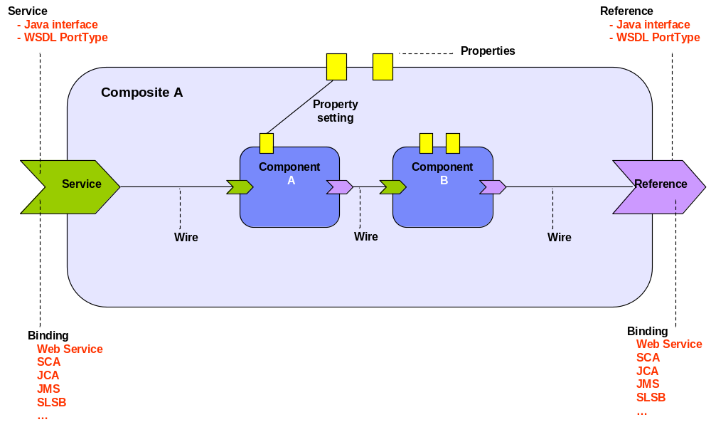
Composite

Slide 6
SCA Interaction Model
Synchronous & Asynchronous service relationships
Scoping and Lifecycle
Conversational services
Asynchronous support
  “non-blocking” invocation
  asynchronous client to synchronous service
  callbacks

Slide 7
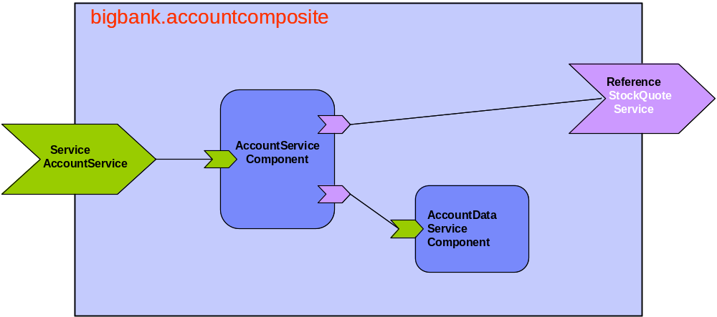
Example

Slide 8
sca file for bigbank.accountcomposite
<?xml version="1.0" encoding="ASCII"?>
<composite xmlns="http://www.osoa.org/xmlns/sca/0.9"
name="bigbank.accountcomposite" >
<service name="AccountService">
<interface.java interface="services.account.AccountService"/>
<binding.ws port="http://www.bigbank.com/AccountService#
wsdl.endpoint(AccountService/AccountServiceSOAP)"/>
<reference>AccountServiceComponent</reference>
</service>
<component name="AccountServiceComponent">
<implementation.java class="services.account.AccountServiceImpl"/>
<property name=“currency”>EURO</property>
<reference name="accountDataService" target="AccountDataServiceComponent"/>
<reference name="stockQuoteService" target="StockQuoteService"/>
</component>
<component name="AccountDataServiceComponent">
<implementation.java class="services.accountdata.AccountDataServiceImpl"/>
</component>
<reference name="StockQuoteService">
<interface.java interface="services.stockquote.StockQuoteService"/>
<binding.ws port="http://www.quickstockquote.com/StockQuoteService#
wsdl.endpoint(StockQuoteService/StockQuoteServiceSOAP)"/>
</reference>
</composite>

Slide 9
State of the Tuscany Project
M1 for Java in May 06
  Based on the programming model from the 0.9 spec
  Runtime integrated with Apache Tomcat
  Support for Java and JavaScript components
  Support for Axis2, Celtix and JSON-RPC bindings
Release Candidate now available for C++ runtime
  Support C++ and WSDL interface types
  Support for C++ components
  Support for Axis2 bindings

Slide 10
Simple Component Implementation
Service Interface exposed by the component
Property used to configure the component
@Service(HelloWorldService.class)
public class HelloWorldImpl implements HelloWorldService {
@Property
public String message;
private UserService userService;
@Reference
public void setUserService(UserService service) {
this.userService = service;
}
public String getGreetings(String id) {
String name = userService.getName(id);
return message + name;
}
}
Reference to a service used by this component

Slide 11
Command Line Client
Locate the
running composite
public static final void main(String[] args) {
// Create a Tuscany runtime for the sample module component
TuscanyRuntime tuscany = new TuscanyRuntime("HelloWorldModuleComponent",
"http://helloworld");
// Start the Tuscany runtime and associate it with this thread
tuscany.start();
// Get the SCA module context.
ModuleContext moduleContext = CurrentModuleContext.getContext();
// Locate the HelloWorld service
HelloWorldService helloworldService =
(HelloWorldService) moduleContext.locateService("HelloWorldComponent");
// Invoke the HelloWorld service
String value = helloworldService.getGreetings("World");
System.out.println(value);
// Disassociate the runtime from this thread
tuscany.stop();
// Shut down the runtime
tuscany.shutdown();
}
Locate a
specific component

Slide 12
Looking Forward …
  Series of spec revisions coming up
    Spec APIs being developed in Tuscany
    Proposals for new functionality
    Prototype in project sandbox
  Need to improve current codebase
    M1 a little fragile, SPIs could use improvement
    Support for SOA policies e.g. security
    Support additional languages and protocols
    Interop and integration between Java and C++ runtimes
    Basically, we need more stuff

Slide 13
Really Looking Forward …
Tuscany is a framework for supporting SOA applications
  Multi-language, multi-protocol, multi-platform
Allows developers to write applications their way
  Naturally supports programming models most suited to the application
  Provides the glue needed to connect the service components together
    Mediations to fix impedance mismatch between services
    Policies to support infrastructure requirements
Stuff just works together
  And we’ve taken the arm-waving out of SOA

Slide 14
Get Involved
http://incubator.apache.org/projects/tuscany
mailto:tuscany-dev@ws.apache.org
Wide variety of implementations
  Runtimes in both Java and C++
  SCA component framework
  Language and protocol integration plugins
  SDO data binding technology
  SOA Data Access Service
BOF at 8PM Thursday

